Slide 1
Multi-Scenario Field Development Planning
Multi-Scenario
Field Development Planning
2022

Slide 2
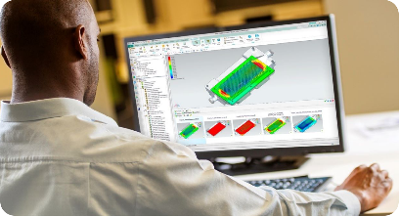
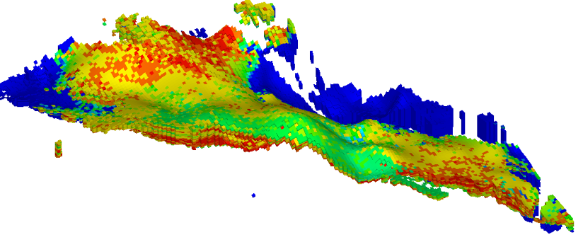
Conventional approach to creating FDP using a dynamic model
3D model of the asset
In case of vast majority of assets, there is currently a physical limit to how far the operating company can go in assessing the opportunities for production enhancement, as it all comes down to the significant labor costs of Simulation Engineers to calculate various scenarios.
Usually only a few scenarios are calculated for different capital costs, leaving unconventional production enhancement opportunities out from the analysis, that could have yielded far better results.
Reservoir Simulation Engineer
Field Development Planning
Scenario 1. Low costs
Scenario 2. Average costs
Scenario 3. High costs
Optimal FDP: maximum NPV
2

Slide 3
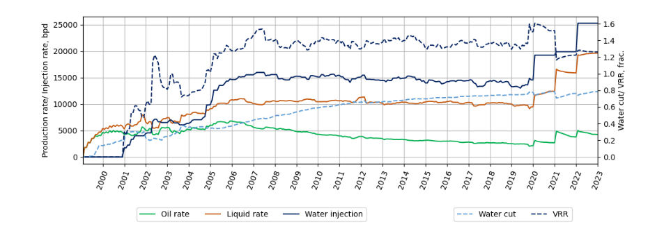
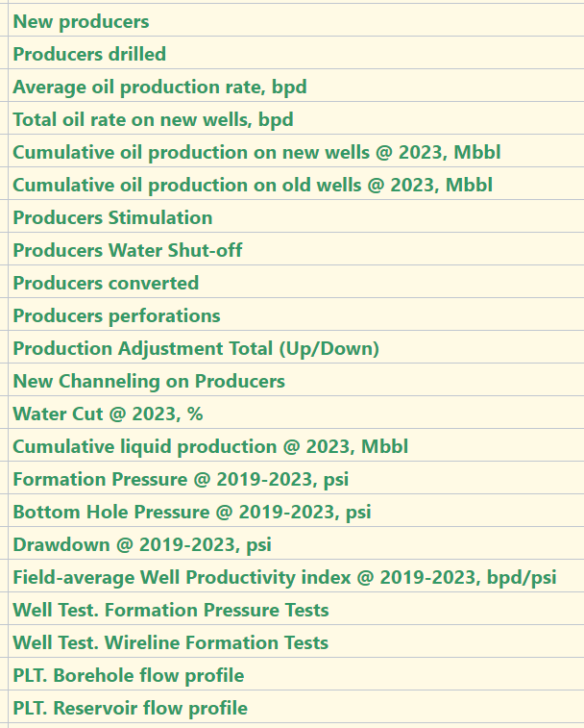
The goals of MSDP
Multi-Scenario Field Development Planning
Production forecast for each scenario
The primary goal of this process is to identify the FDP scenario with the highest NPV (NPV) using a multi-scenario approach.
FDP Team
FDP created by R&D and Asset team
Choosing the best scenario: highest NPV and lowest risk
…
Scenario 1
Scenario 2
Scenario 3
Scenario N
The team's actions
Results
Creating multiple scenarios through PolyPlan web application with an intuitive user interface
Responsive reserves
3D model of high reserves
3D model of expected reserves
3D model of low reserves

Slide 4
Field Review
Example of implementation
This multi-layer asset has 50 years of production history and currently has a high water cut
The most promising block was selected based on the results of a high-level block analysis, and the production history, adjusted to the results of cross-well surveillance for further multi-scenario calculations.
4

Slide 5
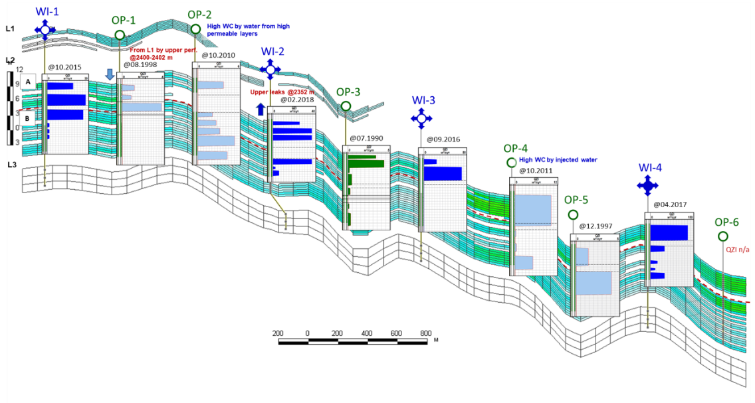
Accounting for petrophysics and production logging
The model is adjusted to the results of petrophysical analysis of geological formation units, the production history is recalculated for each unit (A, B, and C) based on production logging results.
5

Slide 6
Current distribution of reserves
Before calibration
After calibration
Current distribution of recoverable reserves in the main geological formation units A, B, and C based on reinterpretation of production logging, OH Logs, and petrophysics results
6

Slide 7
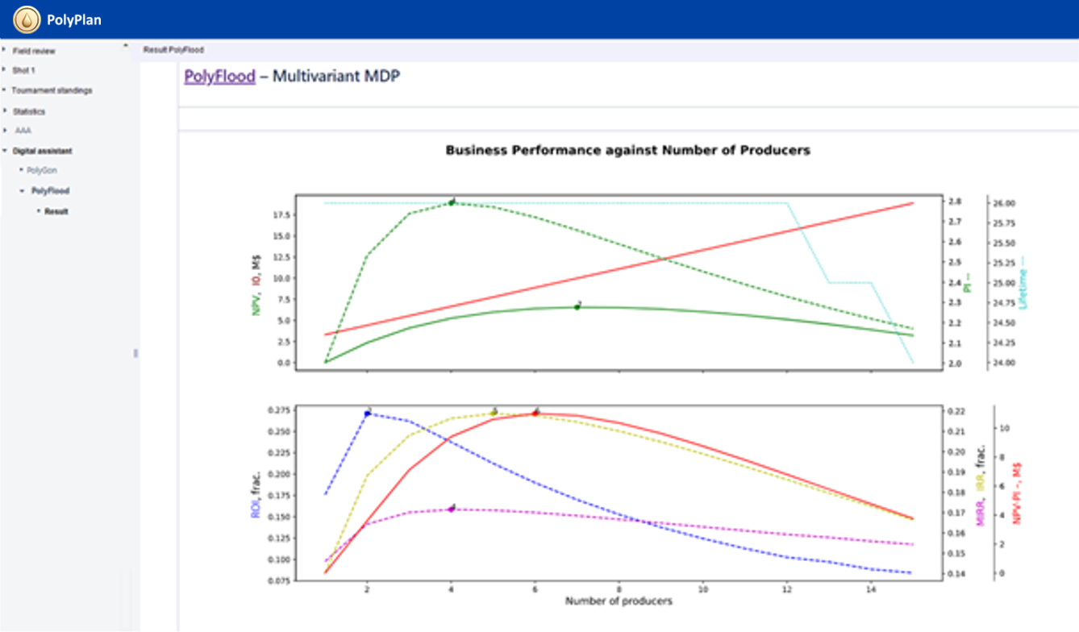
PolyFlood features. KPI
An example of a high-level analysis of optimal FDP scenarios based on the 1D-proxy of a digital asset twin.
Multi-scenario express calculations are performed for a different number of wells with different completions, assuming a high sweep efficiency and constant reservoir pressure is maintained.
The optimal number of wells and their completion are chosen with the goal of maximizing the key economic parameters used to evaluate the efficiency of asset development - KPI
7

Slide 8
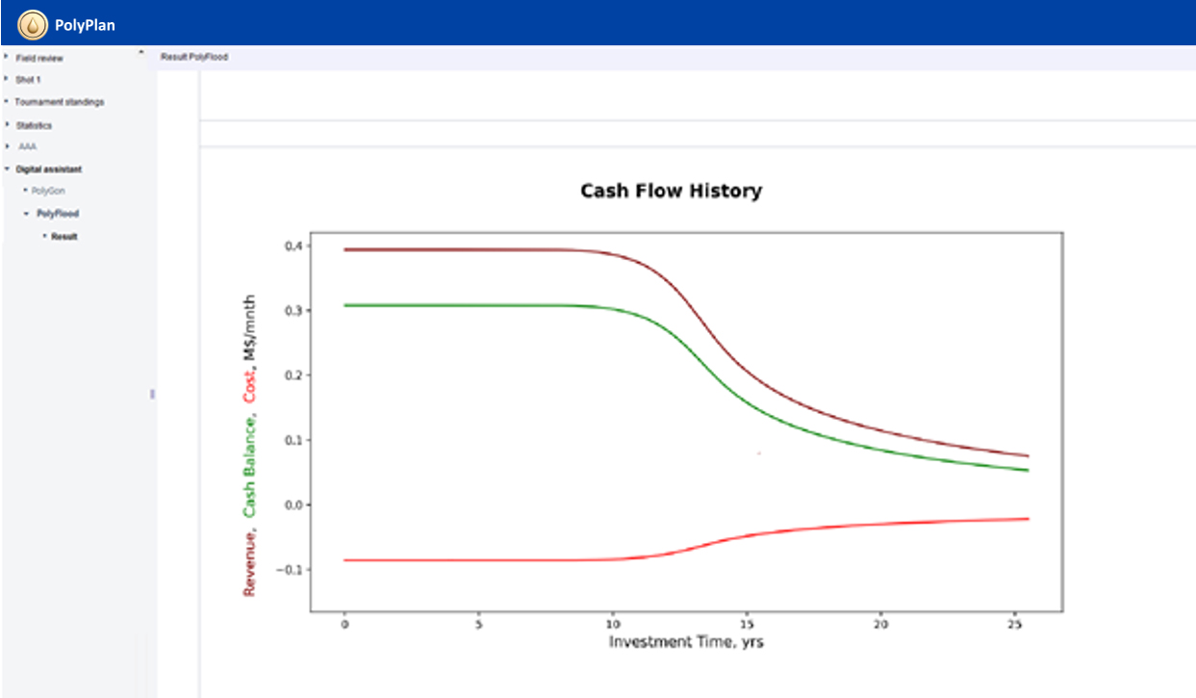
PolyFlood features. Cash flow
Example of cash flow based on multivariate calculations performed in a 1D-proxy digital asset twin
8

Slide 9
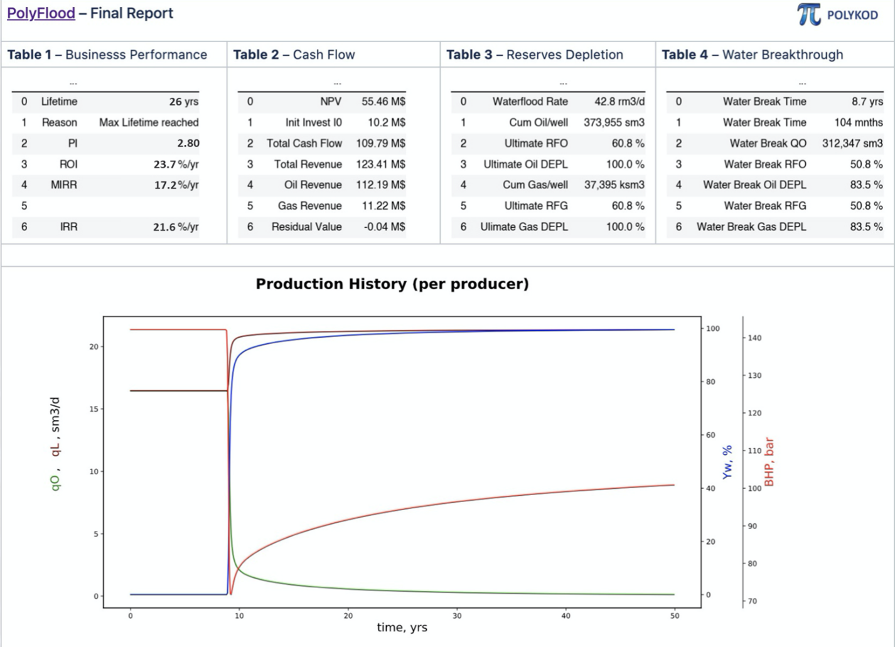
PolyFlood features. Final report
Final report with a selected development scenario based on the results of 1D-proxy modelling
9

Slide 10
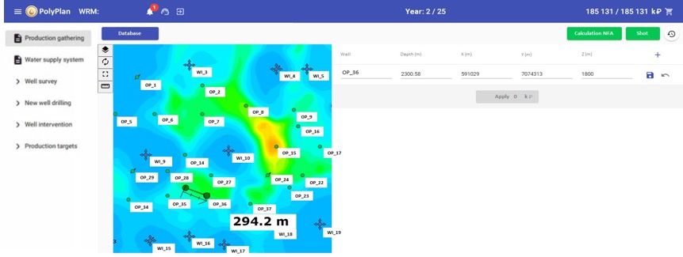
Features of PolyPlan. 3D digital asset twin Drilling
In just a few clicks, the application interface allows to set projected position of a well, perform perforation, and set production target, which are then transmitted to a 3D simulator for dynamic model calculations.
10

Slide 11
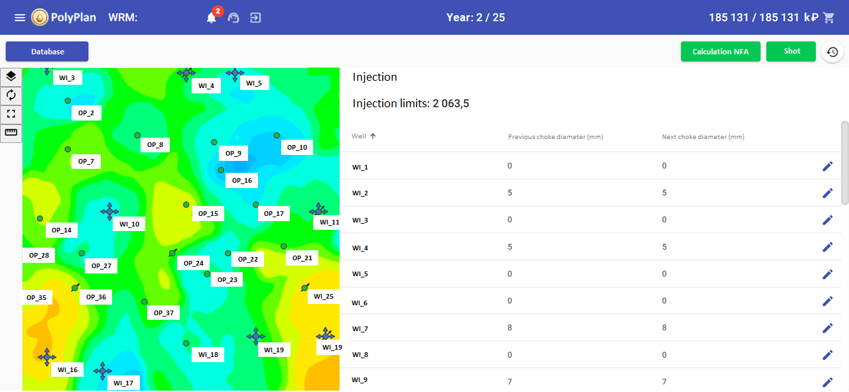
Features of PolyPlan. 3D digital asset twin Optimization of production targets
In just two clicks, the software interface allows to set the desired production target of each injector in a digital asset twin and calculate the asset response in a 3D dynamic simulator
11

Slide 12
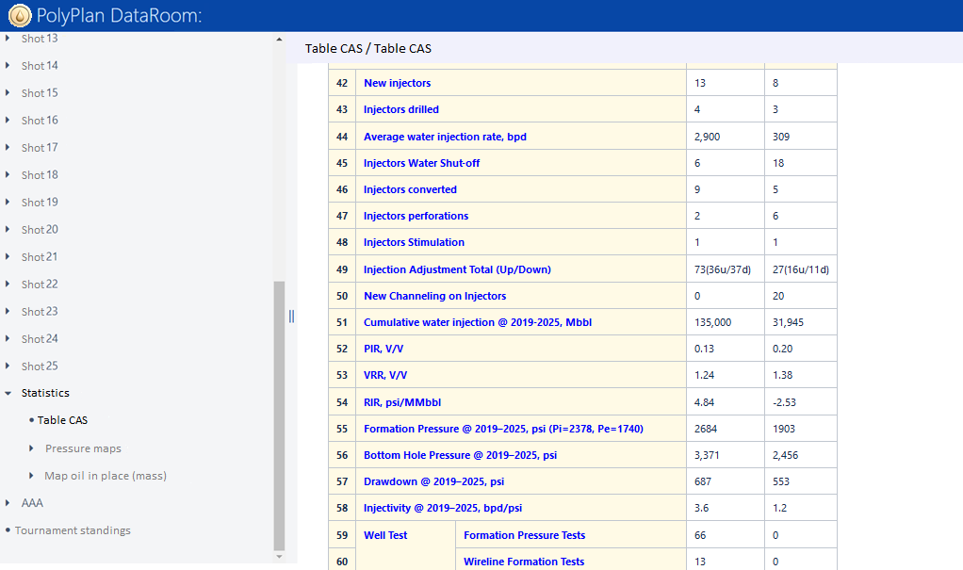
Features of PolyPlan. 3D digital asset twin Statistics for a specific development scenario
An automatically generated report containing the performance results of a petroleum engineering team that assists in selecting the optimal development scenario and performing a quick comparison of the operation results of different teams to pick the most effective actions for each scenario.
12

Slide 13
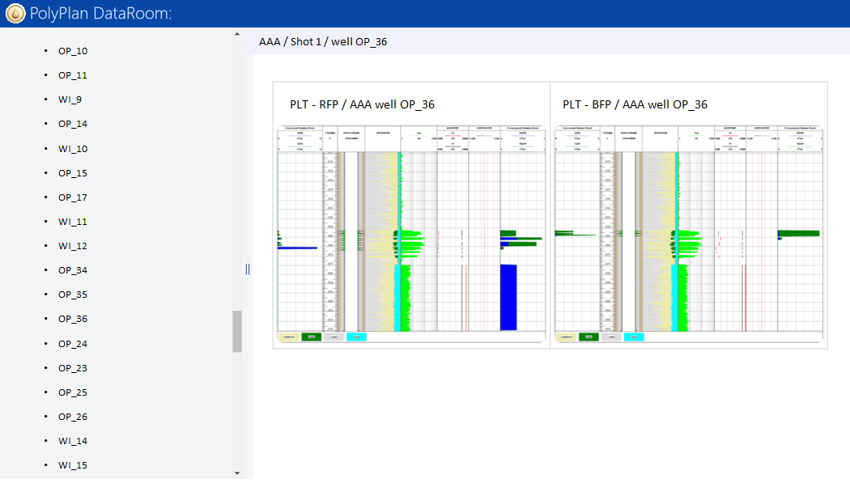
Features of PolyPlan. 3D digital asset twin Modeling well surveillance
Based on the information from a 3D model, field responses are automatically generated in the form of production logging, well testing, and OH results for each existing or newly drilled well, helping to plan an optimal strategy for monitoring field development using a 3D digital asset twin.
13

Slide 14
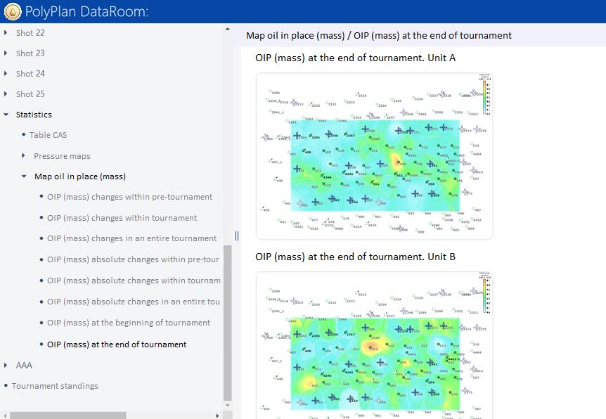
Features of PolyPlan. 3D digital asset twin Distribution of reserves
An automatically generated map revealing the distribution of current recoverable reserves, simplifying compaction drilling and production optimization decisions.
14

Slide 15
Features of PolyPlan. 3D digital asset twin Formation pressure distribution
An automatically generated map revealing the distribution of current reservoir pressure, simplifying pressure support management for production optimization decisions.
15

Slide 16
The development plan for block B18, adjusted by the digital asset twin. Drilling
Horizontal drilling in areas with the highest concentration of current recoverable reserves into formation units with the highest permeability - A&B was chosen as the most economically viable option for the tested block.
16

Slide 17
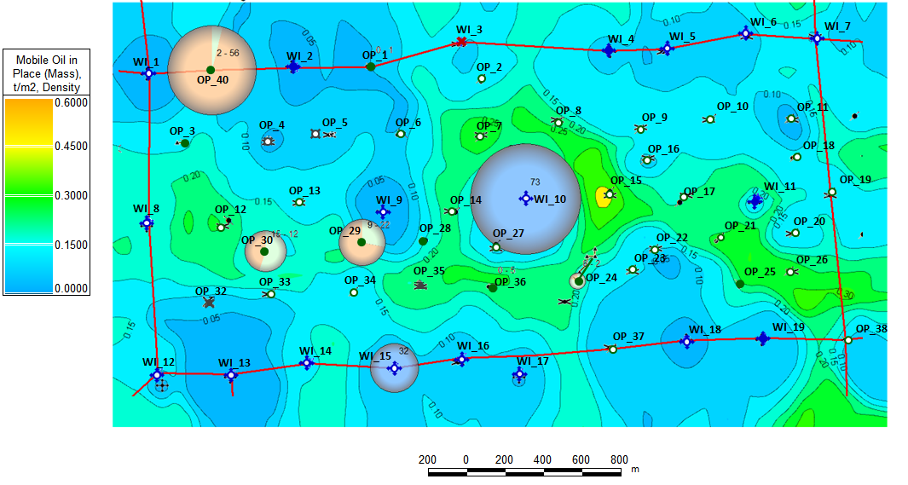
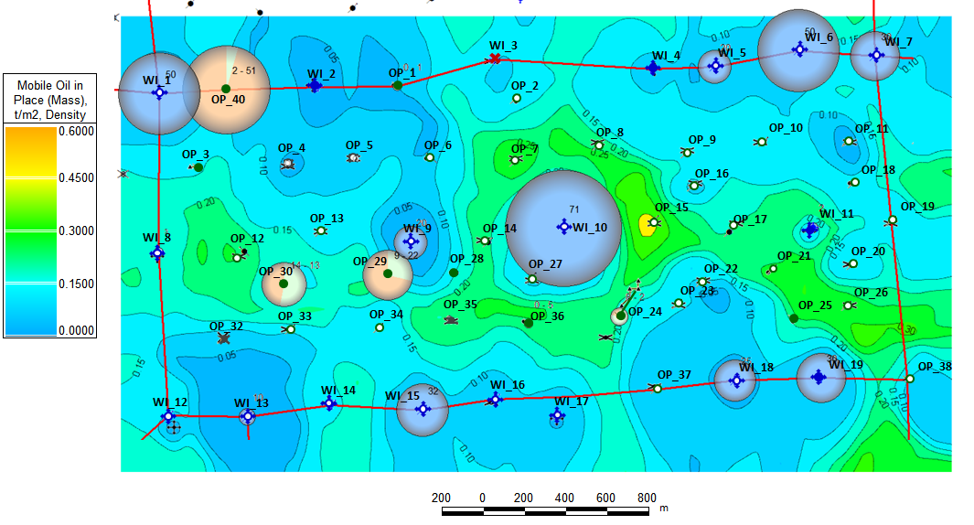
The development plan for block B18, adjusted by the digital asset twin. Water/gas shut-offs and production target optimization
Production target optimization of producers and injectors is the most cost-effective activity which enchases oil recovery by increasing reservoir pressure and drawdown
Current production-injection bubble map
Planning production-injection bubble map
17

Slide 18
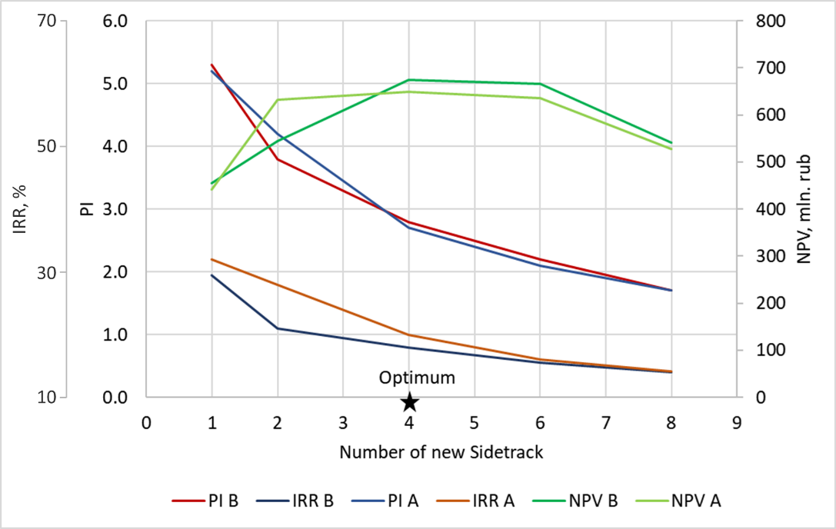
The key KPI values that help to select the optimal number of side-tracks
Creating a visual comparison of key KPI values for various development scenarios allows quick selection of the best option.
18

Slide 19
Comparison of KPI values of different redevelopment scenarios for block 18
Scenario | Formation unit | Drilling side-tracks | Commissioning shut-in water flood wells | Cumulative oil production km ³ | Increased oil production km ³ | Cumulative water production km ³ | Costs, 10 ⁶ ₽ | NPV, 10⁶ ₽ | PI
V0 (base) | A+B+C | - | - | 103 |  | 458 | 0 | -46 | -
V1.1.1 | A | 1 OP | WI | 552 | 448 | 996 | 105 | 441 | 5.2
V1.2.1 | A | 2 OP | WI | 710 | 607 | 1271 | 195 | 633 | 4.2
V1.3.1 | A + B | 4 OP | WI | 756 | 653 | 1574 | 375 | 650 | 2.7
V1.4.1 | A | 6 OP | WI | 833 | 730 | 1544 | 555 | 635 | 2.1
V1.5.1 | A | 8 OP | WI | 822 | 719 | 1528 | 735 | 527 | 1.7
V1.1.2 | B | 1 OP | WI | 573 | 470 | 929 | 105 | 456 | 5.3
V1.2.2 | B | 2 OP | WI | 668 | 565 | 957 | 195 | 545 | 3.8
V1.3.2 | B | 4 OP | WI | 788 | 685 | 1117 | 375 | 675 | 2.8
V1.4.2 | B | 6 OP | WI | 874 | 770 | 1095 | 555 | 666 | 2.2
V1.5.2 | B | 8 OP | WI | 847 | 744 | 1016 | 735 | 541 | 1.7
V2 | A | 2 OP + 2 WI | OP + WI | 794 | 691 | 2505 | 375 | 618 | 2.6
V3 | A | 4 WI | OP + WI | 710 | 607 | 2618 | 375 | 326 | 1.9
19

Slide 20
The key KPI values of the implemented development scenario
Selected well for side-tracking | Well # | formation unit A |  |  | formation unit B
 |  | NPV (NPV) mln. ₽ | PI | Cumulative oil production km ³ | NPV (NPV) mln. ₽ | PI | Cumulative oil production km ³
OP_7-2 | OP_7 | 161 | 3.3 | 149 | 46 | 1.6 | 71
OP_32-2 | OP_32 | 46 | 1.6 | 48 | 54 | 1.8 | 61
OP_12-2 | OP_12 | 258 | 4.6 | 202 | 283 | 5 | 233
OP_20-2 | OP_20 | 80 | 2.1 | 87 | 171 | 3.4 | 137
20

Slide 21
Conclusions
At this asset, there are opportunities for cost-effective production enhancement in the selected block B18, even at a high discount rate and a high cost of workovers.
The digital asset twin has demonstrated its effectiveness in identifying optimal development scenarios.
21

Slide 22
Thank you for your attention!
www.sofoil.com

